Slide 1
Chapter 12: Mass-Storage Systems

Slide 2
Overview of Mass Storage Structure
Magnetic disks provide bulk of secondary storage of modern computers
  Drives rotate at 60 to 200 times per second
  Transfer rate is rate at which data flow between drive and computer
  Positioning time (random-access time) is time to move disk arm to desired cylinder (seek time) and time for desired sector to rotate under the disk head (rotational latency)
  Head crash results from disk head making contact with the disk surface
Drive attached to computer via I/O bus
  Busses vary, including EIDE, ATA, SATA, USB, SCSI
  Host controller in computer uses bus to talk to disk controller built into drive or storage array

Slide 3

What Does The Disk Look Like?

Slide 4
Some Parameters
2-30 heads (platters * 2)
  diameter 14’’ to 2.5’’
700-20480 tracks per surface
16-1600 sectors per track
Sector size:
  64-8k bytes
  512 for most PCs
  Note: inter-sector gaps
Capacity: 20M-300G
Main adjectives: BIG, slow

Slide 5
Disk Overheads
To read from disk, we must specify:
  cylinder #, surface #, sector #, transfer size, memory address
Latency includes:
  Seek time: to get to the track
  Latency time: to get to the sector (rotation delay)
  Transfer time: get bits off the disk
Track
Sector
Rotation
Delay
Seek Time

Slide 6
How is the Disk Formatted?
After manufacturing disk has no information
  Is stack of platters coated with magnetizable metal oxide
Before use, each platter receives low-level format
  Format has series of concentric tracks
  Each track contains some sectors
  There is a short gap between sectors
Preamble allows h/w to recognize start of sector
  Also contains cylinder and sector numbers
  Data is usually 512 bytes
  ECC field used to detect and recover from read errors

Slide 7
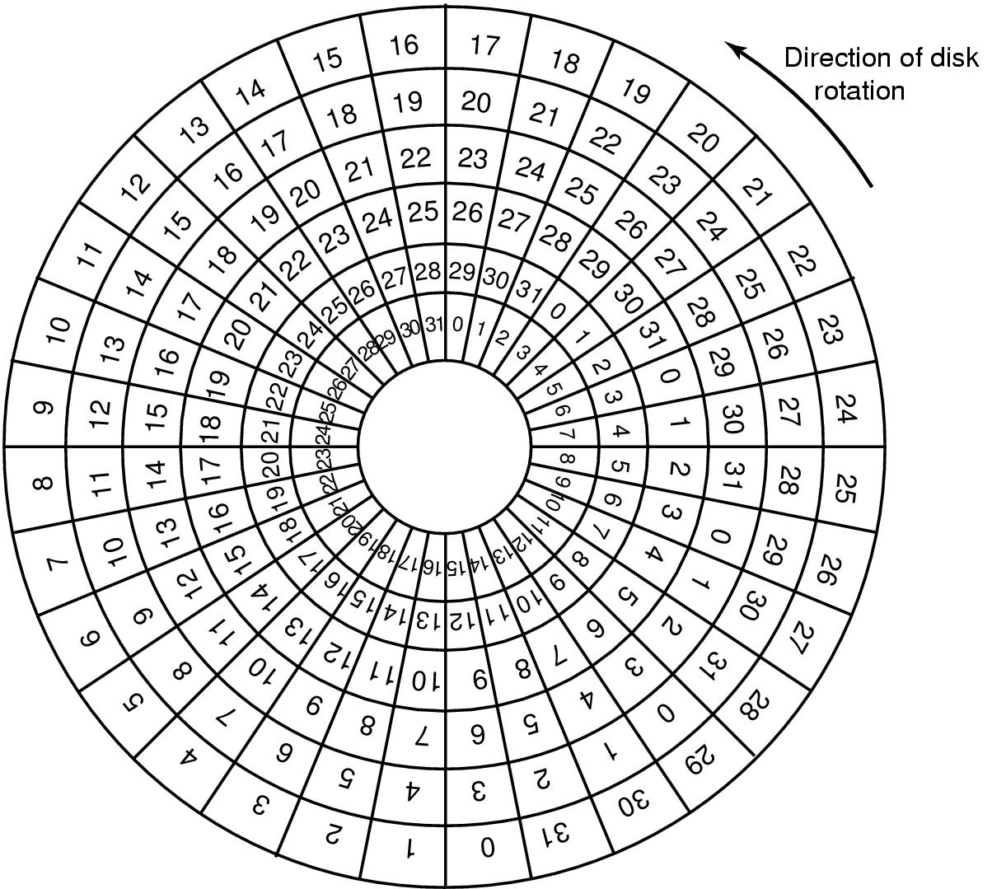
Cylinder Skew
Why cylinder skew?
How much skew?
Example, if
  10000 rpm
    Drive rotates in 6 ms
  Track has 300 sectors
    New sector every 20 µs
  If track seek time 800 µs
    40 sectors pass on seek
Cylinder skew: 40 sectors

Slide 8
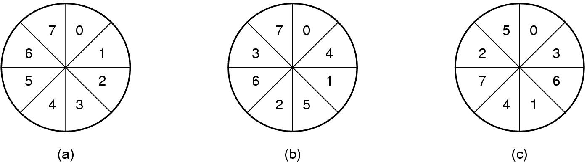
Formatting and Performance
If 10K rpm, 300 sectors of 512 bytes per track
  153,600 bytes every 6 ms ⇒ 24.4 MB/sec transfer
If disk controller buffer can store only one sector
  For 2 consecutive reads, 2nd sector flies past during memory transfer of 1st track
  Idea: Use single/double interleaving

Slide 9
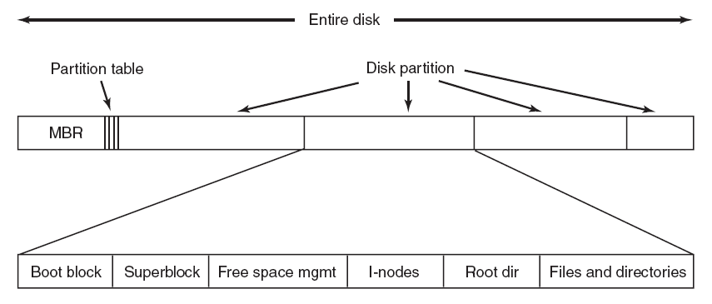
Disk Partitioning
Each partition is like a separate disk
Sector 0 is Master Boot Record (MBR)
  Contains boot code + partition table (starting sector and size)
High-level formatting
  Done for each partition
  Specifies boot block, free list, root directory, empty file system
What happens on boot?
  BIOS loads MBR, boot program checks to see active partition
  Reads boot sector from that partition that then boots OS kernel,

Slide 10
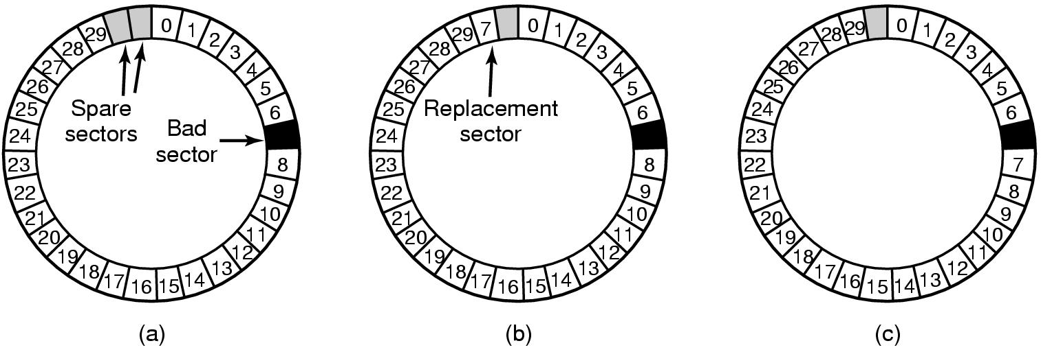
Handling Errors
A disk track with a bad sector
Solutions:
  Substitute a spare for the bad sector (sector sparing)
  Shift all sectors to bypass bad one (sector forwarding)

Slide 11
Disk Scheduling
The operating system tries to use hardware efficiently
  for disk drives ⇒ having fast access time, disk bandwidth
Access time has two major components
  Seek time is time to move the heads to the cylinder containing the desired sector
  Rotational latency is additional time waiting to rotate the desired sector to the disk head.
Want to minimize seek time
Seek time ≈ seek distance
Disk bandwidth is total number of bytes transferred, divided by the total time between the first request for service and the completion of the last transfer.

Slide 12
Disk Scheduling (Cont.)
Several algorithms exist to schedule the servicing of disk I/O requests.
We illustrate them with a request queue (0-199).
98, 183, 37, 122, 14, 124, 65, 67
Head pointer starts at 53

Slide 13

FCFS (First-Come First Serve)
Illustration shows total head movement of 640 cylinders.

Slide 14

SSTF (Cont.)

Slide 15
SCAN
The disk arm starts at one end of the disk,
  moves toward the other end, servicing requests
  head movement is reversed when it gets to the other end of disk
  servicing continues.
Sometimes called the elevator algorithm.
Illustration shows total head movement of 208 cylinders.

Slide 16

SCAN (Cont.)

Slide 17
C-SCAN
Provides a more uniform wait time than SCAN.
The head moves from one end of the disk to the other.
  servicing requests as it goes.
  When it reaches the other end it immediately returns to beginning of the disk
    No requests serviced on the return trip.
Treats the cylinders as a circular list
  that wraps around from the last cylinder to the first one.

Slide 18

C-SCAN (Cont.)

Slide 19
C-LOOK
Version of C-SCAN
Arm only goes as far as last request in each direction,
  then reverses direction immediately,
  without first going all the way to the end of the disk.

Slide 20

C-LOOK (Cont.)

Slide 21
Selecting a Good Algorithm
SSTF is common and has a natural appeal
SCAN and C-SCAN perform better under heavy load
Performance depends on number and types of requests
Requests for disk service can be influenced by the file-allocation method.
Disk-scheduling algo should be a separate OS module
  allowing it to be replaced with a different algorithm if necessary.
Either SSTF or C-LOOK is a reasonable default algo

